Slide 1





ATHENAHEALTH INC. NASDAQ: ATHN

Slide 2



Team Members
AHSAN AVAIS
VARUN HARIHARAN
XIAOFENG LU
ZHEN SU

Slide 3


ATHENAHEALTH, INC.
Founded in 1997 in Watertown, MA
Integrated Healthcare Management Software as a Service (SaaS):
Collector: Billing and Collection
Clinicals: Electronic Health Records
Communicator: Patient Communications
Clarity: Data Analytics
Has a 5% Market Share

Slide 4
Investment Recommendation
$130
$176
$196
Upside Potential 22%
$186
$171
$162
Cloud
$139
Enterprise Deals
$127
BUY
HOLD
Cross-Selling
Epocrates
Mar-14
Company Overview
Revenue
Drivers
Industry & Competitors
Financial Analysis and Valuation
Risk Analysis & Conclusion
CFA Institute Research Challenge

Slide 5
Company Overview
Communicator
Optimizes patient scheduling
Alerts patients of visits, referrals, and results
Allows for virtual consults (e-visits)
Billing Manager
Pay-for-Performance: ATHN gets paid ONLY if physician collects
Puts health records in the cloud for universal access
Exceeds government regulations
Shifts interface to mobile platforms
SaaS eliminates upfront IT costs
Clinicals
Collector
Company Overview
Revenue
Drivers
Industry & Competitors
Financial Analysis and Valuation
Risk Analysis & Conclusion
CFA Institute Research Challenge

Slide 6
Company Overview
35% CAGR
40% CAGR
Company Overview
Revenue
Drivers
Industry & Competitors
Financial Analysis and Valuation
Risk Analysis & Conclusion
CFA Institute Research Challenge

Slide 7
Epocrates
Cross Selling
Enterprise Deals
Cloud
Company Overview
Revenue
Drivers
Industry & Competitors
Financial Analysis and Valuation
Risk Analysis & Conclusion
CFA Institute Research Challenge

Slide 8
Epocrates
Cross Selling
Enterprise Deals
Cloud
ATHN
5% US Physicians
EPOC
50% US Physicians
Company Overview
Revenue
Drivers
Industry & Competitors
Financial Analysis and Valuation
Risk Analysis & Conclusion
CFA Institute Research Challenge

Slide 9
Epocrates
Cross Selling
Enterprise Deals
Cloud
ATHN
5% US Physicians
ATHN
10% US Physicians
EPOC
50% US Physicians
Company Overview
Revenue
Drivers
Industry & Competitors
Financial Analysis and Valuation
Risk Analysis & Conclusion
CFA Institute Research Challenge

Slide 10
Epocrates
Cross Selling
Enterprise Deals
Cloud
Collector
100%
Communicator
52%
21%
14%
35%
31%
Clinicals

Slide 11
Epocrates
Cross Selling
Enterprise Deals
Cloud
Cross-selling in new deals
Single Barrel
Single Barrel
Double Barrel
Ascension Deal
Double Barrel
Ascension Deal
Triple Barrel
Triple Barrel
Company Overview
Revenue
Drivers
Industry & Competitors
Financial Analysis and Valuation
Risk Analysis & Conclusion
CFA Institute Research Challenge

Slide 12
Epocrates
Cross Selling
Enterprise Deals
Cloud
Enterprise-Sized growth by Physician Group Size
# of physicians
12% CAGR
141% CAGR
IT Cost Savings of 40%
Ascension Deal
Company Overview
Revenue
Drivers
Industry & Competitors
Financial Analysis and Valuation
Risk Analysis & Conclusion
CFA Institute Research Challenge

Slide 13
Epocrates
Cross Selling
Enterprise Deals
Cloud
Company Overview
Revenue
Drivers
Industry & Competitors
Financial Analysis and Valuation
Risk Analysis & Conclusion
CFA Institute Research Challenge

Slide 14
Competition
Revenue Growth Rate
ATHN
Company Overview
Revenue
Drivers
Industry & Competitors
Financial Analysis and Valuation
Risk Analysis & Conclusion
CFA Institute Research Challenge

Slide 15
Revenue Growth
Cloud - based Market
ACA
Shift to Cloud
Collections / Physician
Number of Physicians using Cloud
ATHN
Cross Selling
Epocrates
Enterprise Deals
Revenue / Physician
Number of Physicians using ATHN
Revenue for ATHN
Company Overview
Revenue
Drivers
Industry & Competitors
Financial Analysis and Valuation
Risk Analysis & Conclusion
CFA Institute Research Challenge

Slide 16
Financial Analysis
EPS aligned with improving margins
Deleveraging and increasing FCF
Debt = $223.7M
Headcount Increase
EBIT Margin
Debt/Equity
AOTC
EPOC
Arsenal on the Charles
41%
Epocrates
59%
EPOC
FCF
EPS
Company Overview
Revenue
Drivers
Industry & Competitors
Financial Analysis and Valuation
Risk Analysis & Conclusion
CFA Institute Research Challenge

Slide 17
Multiples Valuation
Cloud
Server
Group | Weights
Cloud-based | 80%
Server-based | 20%
Multiple Price: $168
Company Overview
Revenue
Drivers
Industry & Competitors
Financial Analysis and Valuation
Risk Analysis & Conclusion
CFA Institute Research Challenge

Slide 18
DCF Assumptions
EPOC
Sales CAGR
Cross Selling
$197
Bull
(30%)
15%
37%
Major
$165
Base
(50%)
10%
33%
Partial
DCF Price: $169
$138
Bear
(20%)
5%
24%
Minor
Company Overview
Revenue
Drivers
Industry & Competitors
Financial Analysis and Valuation
Risk Analysis & Conclusion
CFA Institute Research Challenge

Slide 19
Sensitivity Analysis
Mean
Actual Revenue
Expected Revenue
Uncertainty
Company Overview
Revenue
Drivers
Industry & Competitors
Financial Analysis and Valuation
Risk Analysis & Conclusion
CFA Institute Research Challenge

Slide 20
Simulation
Current Price
176
Mean
177
Company Overview
Revenue
Drivers
Industry & Competitors
Financial Analysis and Valuation
Risk Analysis & Conclusion
CFA Institute Research Challenge

Slide 21
Target Price
DCF Price: $169
50%
Multiple Price: $168
25%
$171
Bootstrap: $177
25%
Company Overview
Revenue
Drivers
Industry & Competitors
Financial Analysis and Valuation
Risk Analysis & Conclusion
CFA Institute Research Challenge

Slide 22
Investment Risks
Market risk | Operational risk | Regulation risk
 | Unfavorable changes in the IT Regulation
 |  | ACA fails to increase patient traffic | Greater Competition | Failure to Cross Sell
 | Industry Consolidation | Failure to maintain Enterprise Growth Rate | Cloud does not grow as expected | EPOC failure impacts long term growth rate
Probability
Impact
Company Overview
Revenue
Drivers
Industry & Competitors
Financial Analysis and Valuation
Risk Analysis & Conclusion
CFA Institute Research Challenge

Slide 23
Current Price
$176
Epocrates
Cross-Selling
HOLD
Enterprise Deals
Cloud
Target Price
$171
Company Overview
Revenue
Drivers
Industry & Competitors
Financial Analysis and Valuation
Risk Analysis & Conclusion
CFA Institute Research Challenge
CFA Institute Research Challenge

Slide 24
Thank You!

Slide 25
Forecast & Valuation
Revenue Driver
Survey
Main
Income Statement
EPOC
Survey Highlight
Company Overview
4Q Results
I/S Common Size
Sample Size Calculation
Margin
Enterprise Account
Physician Growth
Balance Sheet
Role of Practice
Cloud
Epoc
Cross. Selling
L / M Term
Cash Flow
Age Demographics
Ease of use
Cloud
Why Hold
2013 Fin. Activities
Enterprise
Size of Practice
Catalyst Buy
Base Case
Industry
Industry
Rev.M
Type of MNG System
Catalyst Sell
Bull Case
Fin.A
Multiple
ACA
Features of Service
Acquisition
Bear Case
SWOT
When to Change
DCF
Bootstrap
Pricing
Comparable Summary
Porter’s Five Forces
Switch to Cloud Based
Risk
Conclusion
DCF Assumption
Comparable Companies
Management
Technical Support
HITECH
IT Cost Model
Additional
Board of Directors
Mobile Application
Data Security
Cushion Model
Shift to Cloud
Frequency
D & A Detail
Multiple Weight
Compensation
Revenue Breakdown
Stock Information
Rev/ Employee
Rationale for Weight
Ownership
Stock Price Chart
Short Selling
Bootstrap
Insider

Slide 26
Income Statement

Slide 27
Income Statement – Common Size
(In U.S. millions) | 2010 | 2011 | 2012 | 2013 | 2014 | 2015 | 2016 | 2017 | 2018 |  | Comments
Total Revenue | 100% | 100% | 100% | 100% | 100% | 100% | 100% | 100% | 100%
- Growth |  | 32% | 30% | 41% | 47% | 40% | 36% | 32% | 30% |  | Forecast based on EPOC-related new business, increased enterprise deals, and 2x /3x barrel sales
Gross Profit | 61% | 62% | 60% | 60% | 61% | 61% | 61% | 62% | 62% |  | In line with historical
Selling General & Admin Exp. | 39% | 39% | 39% | 42% | 39% | 38% | 38% | 38% | 38% |  | In line with historical
R & D Exp. | 8% | 7% | 8% | 10% | 8% | 8% | 8% | 8% | 8% |  | In line with historical
Depr & Amort Exp. | 5% | 5% | 6% | 7% | 10% | 6% | 4% | 3% | 2% |  | Accelerated depreciation model for acquired assets and goodwill
Operating Income | 10% | 10% | 7% | 1% | 4% | 8% | 11% | 13% | 14% |  | Margins improve with economies of scale afforded by SaaS
EBT Incl. Unusual Items | 9% | 10% | 8% | 0% | 3% | 8% | 11% | 13% | 14%
Income Tax Expense | 4% | 4% | 4% | 0% | 1% | 3% | 5% | 5% | 6% |  | Statutory tax rates
Net Income | 5% | 6% | 4% | 0% | 2% | 5% | 6% | 7% | 8% |  | Margins improve with economies of scale afforded by SaaS
Earnings Per Share | 0.37 | 0.54 | 0.52 | 0.07 | 0.46 | 1.57 | 2.89 | 4.61 | 6.74 |  | FY14 does not reach F12 levels; FY15 surpasses it with increased top line revenue
- Growth |  | 46% | -4% | -86% | 565% | 238% | 84% | 60% | 46%

Slide 28
Revenue Breakdown
Growth Rate

Slide 29
Depr. & Amort. Detail
(In U.S. millions) | 2010 | 2011 | 2012 | 2013 | 2014 | 2015 | 2016 | 2017 | 2018
Assumption
No major acquisitions after FY13Q3 - FY13Q3 10Q
Accelerated depreciation model - 10K
CapEx (Net increase in PPE) / Rev | 2.9% | 6.3% | 0.4% | 2.9% | 2.9% | 2.9% | 2.9% | 2.9% | 2.9%
Depr / PPE,net ( Y-1) | 32.2% | 37.6% | 30.6% | 30.6% | 30.6% | 30.6% | 30.6% | 30.6% | 30.6%
Total Depr. & Amort. Exp. | 11.1 | 16.7 | 25.4 | 43.6 | 91.5 | 77.4 | 70.3 | 69.0 | 73.2
% of revenue | 4.5% | 5.2% | 6.0% | 7.3% | 10.3% | 6.2% | 4.1% | 3.0% | 2.3%
Depr. On Tangible Assets
P.P&E | 6.9 | 12.5 | 15.0 | 16.4 | 66.0 | 56.8 | 59.7 | 58.4 | 64.6
Amort. On Intangible Assets
EPOC | - | - | - | 15.2 | 17.7 | 12.7 | 10.6 | 10.6 | 8.6
Healthcare Data Services | - | - | - | 1.6 | 1.6 | 1.6 | - | - | -
Proxsys | - | - | 6.2 | 6.2 | 6.2 | 6.2 | - | - | -
Anodyne Health Partners | 4.2 | 4.2 | 4.2 | 4.2 | - | - | - | - | -
Total Amort. Exp. | 4.2 | 4.2 | 10.4 | 27.2 | 25.5 | 20.6 | 10.6 | 10.6 | 8.6

Slide 30
Balance Sheet

Slide 31
Cash Flow Statement
Notes:
One more slide for 2013 financial act.

Slide 32
2013 Financing Highlights
2013 Financing Activities
In M$
Sources |  | Uses
Operations | 93.3 | EPOC acq. | 242.8
Debt (net) | 223.7 | AOTC acq. | 167.3
Stock | 31.1 | Cap. Ex. | 38.3
Investments | 54.2 | Other | 43.9
Cash | 90.0
Total | 492.3 | Total | 492.3

Slide 33
2013 by Quarter
Revenues and EPS beat Street by 2% and 51% respectively
Rev. /Collection grows 7bp to 4.4%
EBIT margin increased from 1.7% to 11.2%
Stock price climbs 25%

Slide 34
Drivers of 2012/2013 EBIT margin decreases
 | 2012 | Reasons
Total | 3.1%
COGS | 1.6% | 28% headcount increase
SG&A | -0.2%
Stock-based Comp. | 0.1%
R&D Exp. | 0.8% | 45% headcount increase for athenaOne
Depr. & Amort. | 0.8% | Acquisition of Proxsys and MDX Medical in 2011
 | 2013 | Reasons
Total | 6.3%
COGS | 0.6% | 57 EPOC employees adsorbed, increase in stock-based comp.
SG&A | 2.8% | 88 EPOC employees adsorbed, EPOC intangibles expensed
Stock-based Comp. | -0.1%
R&D Exp. | 1.7% | 97 EPOC employees adsorbed
Depr. & Amort. | 1.3% | Acquisition EPOC, ATOC

Slide 35
DCF Assumptions
 | Est. | Basis
WACC | 9.0% | Calculation
Cost of Equity | 10.2% | CAPM
Beta | 1.2 | Regression of ATHN to the Russell 2000 Index
Risk free rate | 3.0% | Yield on U.S. 10-year T-Notes
Equity risk premium | 5.8% | Historical average
Cost of Debt | 1.9% | One-month LIBOR + 1%
Debt/Equity | 0.16 | Industry average
Marginal tax rate | 42.1% | Actual
TV growth rate | 2.7% | Projected U.S. population growth

Slide 36
Base Case DCF

Slide 37
Bull Case DCF

Slide 38
Bear Case DCF

Slide 39
Comparables

Slide 40
Comparable Companies

Slide 41
IT Cost Reduction Model
Hospital Medical Records Department Expense / Total Hospital Revenue
Range | 0.6% - 3.8%
Average | 1.66%
AthenaClinicals Pricing
Range | 1% - 4%
Price for large hospitals | 1%
IT cost reduction | 40%

Slide 42
Revenue/Physician Cushion
Cushion for Bargaining Power Decrease
 | 3Q13 | 3Q15E | Physicians using all 3 products
Communicator | 51% | 83% | 100%
Clinicals | 34% | 73% | 100%
Collector | 100% | 100% | 100%
 | Price range | Average Price
Communicator | 1% - 2% | 1.5%
Clinicals | 1% - 4% | 2.5%
Collector | 2% - 8% | 5.0%
Cushion for bargain power decrease
Rev./Collection–Physician | 6.6% | 8.1% | 9.0%
Cushion |  | 1.5% | 2.4%
Assumptions: | Every physician uses AthenaCollector

Slide 43
Comparables - Rationale for Weights
Weights
Cloud-based | 80%
Server-based | 20%
Name | Mkt. Cap. | PEG | Rev g 2013 | Rev g 2012 | Rev g 2011 | Op. Margin 2012
ATHN | 6,502 | 6.2 | 41% | 30% | 32% | 8%
Cloud-based | 4,107 | 7.7 | 29% | 28% | 32% | 4%
Server-based | 40,212 | 2.8 | 4% | 9% | 17% | 12%
Rationale
Server-based firms have a different business model – e.g. pay up-front for servers, software, and support
Cloud-based firms (SaaS) are in a similar development stage no matter the industry
Server-based weights keep market characteristics and are conservative

Slide 44
Rationale for Valuation Weights
Valuation Method | Weight | Rationale
DCF | 50% | All factors driving cash flows are considered
Multiples | 25% | Considers competitor business models yet reflects differences in development stage
Bootstrap Simulation | 25% | Quantifies revenue volatility

Slide 45
New Bootstrap Simulation Result
Bootstrap Simulation of Annual Revenue for 2013 - 2022
 | 2014 | 2015 | 2016 | 2017 | 2018 | 2019 | 2020 | 2021 | 2022 | 2023
Mean | 853 | 1,249 | 1,745 | 2,387 | 3,259 | 4,413 | 5,975 | 8,087 | 10,945 | 14,821
Median | 853 | 1,249 | 1,745 | 2,386 | 3,255 | 4,410 | 5,969 | 8,076 | 10,926 | 14,785
5th percentile | 824 | 1,190 | 1,645 | 2,229 | 3,021 | 4,060 | 5,453 | 7,339 | 9,877 | 13,300
Predicted Target Price/Share
Mean | 177
Median | 177
5th | 168

Slide 46
EPOC
Increased Awareness:
Among physicians - up from 31% to 39%
Among healthcare executives - up from 35% to 44%
Notes:
Ad. Spend

Slide 47
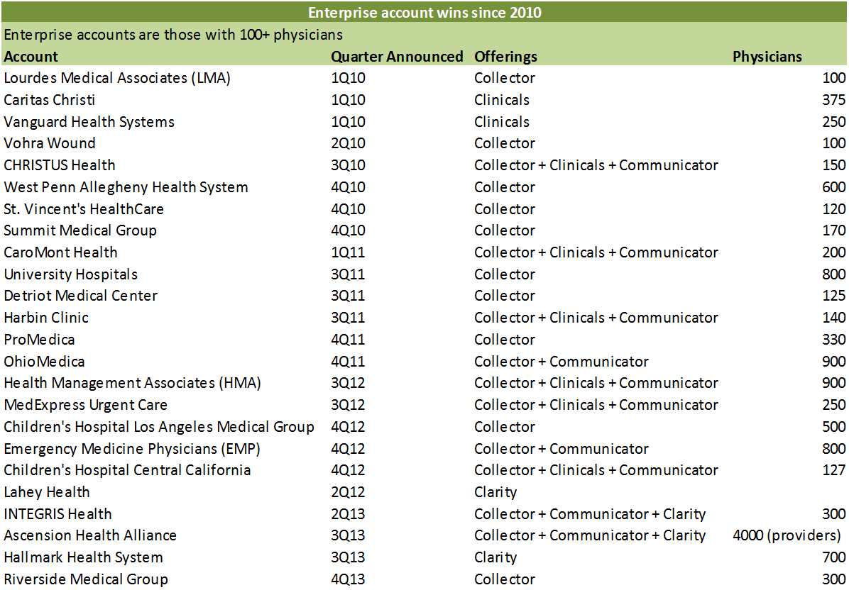
Enterprise Accounts

Slide 48
Advantages of Cloud-Based Technology
Lower Capital Costs
Clients avoid large up-front IT investments
Fast Implementation
All that is required is internet service; faster access to stimulus funds
Off-Loads Security Risks
Avoids building a complex firewall and staffing its monitoring
Virtual Redundancy
Data is stored virtually in servers spread across many locations
Disaster Recovery
Vendors are fully staffed 24/7, so more resources are available
Performance
Vendors guarantee response times; the best offer financial guarantees

Slide 49
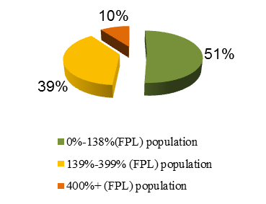
Affordable Care Act

Slide 50
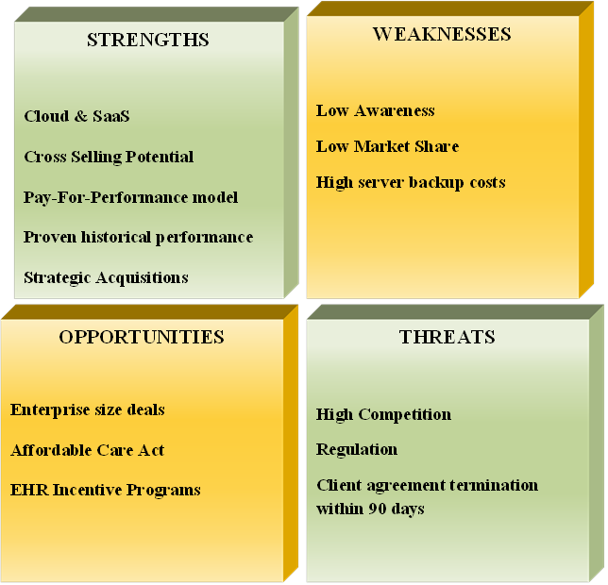
ATHN SWOT Analysis

Slide 51
Industry Analysis
Competitive Positioning of ATHN
(1-lowest intensity to 5 – highest intensity)
Key Healthcare IT Characteristics
High Competition
Rising entry barriers
Low but rising bargaining power of buyers
Threat of substitutes has dropped significantly

Slide 52
Board of Directors

Slide 53
Compensation of Management Team

Slide 54
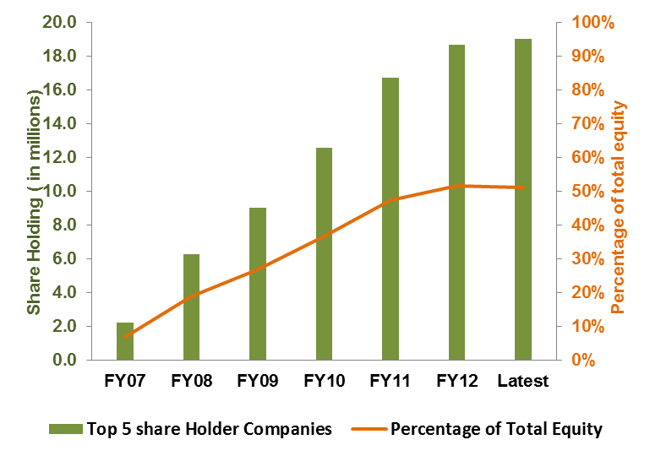
Ownership

Slide 55
Survey

Slide 56
Survey

Slide 57
Survey

Slide 58
Survey

Slide 59
Survey

Slide 60
Survey

Slide 61
Survey

Slide 62
Survey

Slide 63
Survey

Slide 64
Survey

Slide 65
Survey

Slide 66
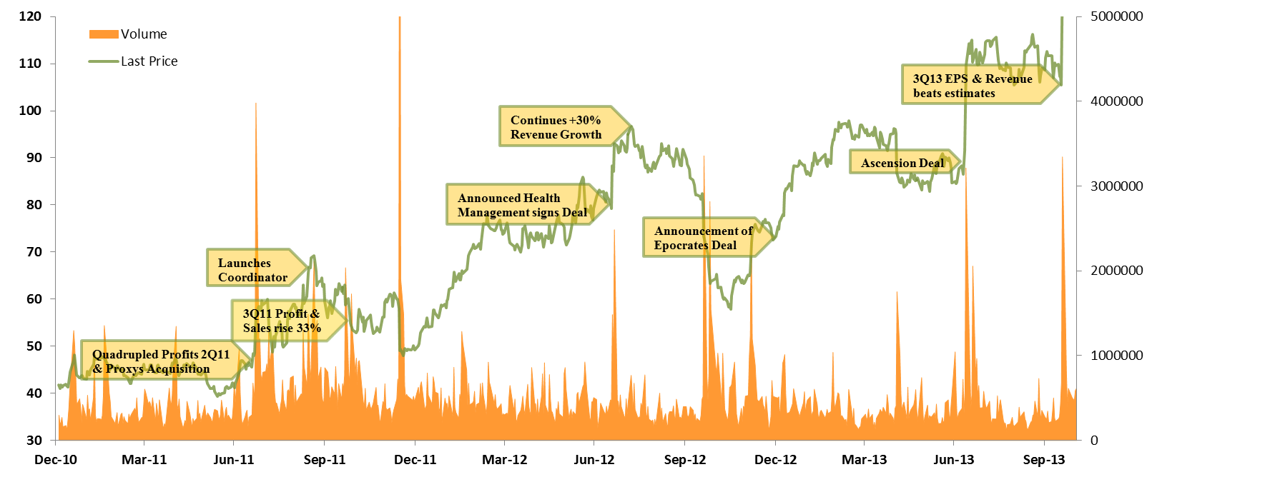
Stock Price Chart

Slide 67
Investment Risks
Market risk | Operational risk | Regulation risk
 | Unfavorable changes in the IT Regulation
 |  | ACA fails to increase patient traffic | Greater Competition | Failure to Cross Sell
 | Industry Consolidation | Failure to maintain Enterprise Growth Rate | Cloud does not grow as expected | EPOC failure impacts long term growth rate
Probability
Impact
Company Overview
Revenue
Drivers
Industry & Competitors
Financial Analysis and Valuation
Risk Analysis & Conclusion
CFA Institute Research Challenge

Slide 68
Market Risk
 | Bears Say | Our View
Greater Competition | Competitors have existing relationships with providers and will work hard to expand their markets | ATHN has gained market share and increased revenue organically Strategic acquisitions like EPOC will boost awareness and market share via mobile devices

Slide 69
Market Risk
 | Bears Say | Our View
Cloud does not grow as expected | Many providers have already invested in their server-based systems and will not switch to a pay for performance model | ATHN can save up to 40% to large groups (e.g. Kaiser Permanente) Ascension proved ATHN can sign up large groups Updating of server systems allows the cloud to serve as solution Industry is moving to SaaS (e.g. EMC retooling to cloud)

Slide 70
Market Risk
 | Bears Say | Our View
Industry consolidates | Over time, consolidation increases customer bargaining power and decreases revenue/collection | ATHN will offset this by cross-selling ATHN can handle this by winning enterprise deals (e.g. Ascension) Revenues/collection will increase over the long term as m-health becomes popular

Slide 71
Operational Risk
 | Bears Say | Our View
EPOC fails to increase revenues significantly | Unrealized synergies are dilutive. ATHN will suffer if it does not retain EPOC users, let alone convert them | EPOC’s high visibility with physicians allows ATHN to cross-sell its best-in-KLAS solutions The long term industry move to m-health plays into EPOC and ATHN’s associated solutions

Slide 72
Operational Risk
 | Bears Say | Our View
ATHN might not be able to keep its high growth rate | It is unrealistic for ATHN to maintain its current growth rate | ATHN’s visibility via EPOC will bring in new clients ATHN’s best-in-KLAS solutions will attract users Cross-selling optimizes MD practice and ATHN’s revenue Move to e-visits and m-health plays to ATHN’s strengths

Slide 73
Operational Risk
 | Bears Say | Our View
Failure to maintain enterprise growth rate | ATHN will lose credibility if they don’t land more enterprise deals | ATHN’s enterprise client base will grow as practices move from servers to cloud-based platforms Projected IT costs savings of 40% are attractive to enterprises under cost pressure

Slide 74
Operational Risk
 | Bears Say | Our View
Failure to Cross-sell | Failure of athenaOne will hurt revenue growth | Practices are moving to outcomes-based care that rely on coordinated IT ATHN has demonstrated its ability to cross-sell ATHN has a best-in-KLAS EHR product Communicator optimizes practice management especially if used with Clarity

Slide 75
Regulation Risk
 | Bears Say | Our View
ACA does not increase patient traffic | ACA will not play out as expected and will not increase patient traffic | The CBO estimates that 6 million Americans will join the insured rolls by FYE14 because of the ACA A significant number of new enrollees are heavier-than-average users

Slide 76
Regulation Risk
 | Bears Say | Our View
HITECH act will not fuel industry growth any further | The industry has already realized all the growth it will get due to IT regulations | ATHN’s pay-for-performance model is attractive to an industry looking to control costs ATHN has been less dependent on HITECH than its competitors

Slide 77
Regulation Risk
 | Bears Say | Our View
Unfavorable changes to IT regulations | Regulatory requirements will force ATHN to change or adapt their software ICD-10 disruption will increase costs | ATHN’s ICD-10 guarantee mitigates this risk

Slide 78
Regulation Risk
 | Bears Say | Our View
Data security concerns will detract from cloud-based solutions | Access to the cloud allows hackers to attack. Industry will react by rejecting the cloud | Medical records are really NOT monetizable No SS numbers are used – Insurance ID is used instead Any networked system is at risk Cloud-based providers, many of which are large financial institutions, constantly protect their data

Slide 79
The Medium and Long Term View for the Industry
 | Medium Term | Long Term
We project the health care industry experiencing the following | A comprehensive move to cloud-based solutions Integration of costs, EHR, and outcomes into coherent cost/benefit calculations Increasing cost pressures drive performance-driven collections | E-visits become new normal, driving usage of Communicator-like solutions M-health medicine becomes new normal, leveraging EPOC architecture Cost pressures force system optimization, helping 3x barrel deals

Slide 80
With ATHN now trading at $176…
Question | Why Hold | Long Term Upside
…and your target price at $171, is it really a hold? | Feb. 7th price increase is purely based due to beating 4Q13 estimates Profit taking is not advisable as ATHN has long term upside, and we are long term investors ATHN has all the fundamentals for solid cash flows | E-visits and m-health will change the industry ATHN’s coordinated solutions will gain, especially Communicator and the EPOC architecture E-visits and m-health reimbursements rates will be a risk

Slide 81
Catalyst for a Buy Position
Question | Preface | We switch to a Buy when…
What will be your catalyst for a buy position? | The ATHN stock price will fall in the near term to the low to mid $170s That said, we are bullish on ATHN in the long term | ≥ 15% of EPOC users switch to ATHN 1x barrel sales are completely replaced by 2x/ 3x barrel sales Enterprise sales rise at a ≥ 14% CAGR E-visits and m-health are considered for reimbursement

Slide 82
Catalyst for a Sell Position
Question | Preface | We switch to a Sell when…
What will be your catalyst for a sell position? | The ATHN stock price will fall in the near term to the low to mid $170s That said, we are bullish on ATHN in the long term | < 5% of EPOC users switch to ATHN 1x barrel sales dominate total sales Enterprise sales rise at a < 5% CAGR E-visits and m-health are not reimbursed

Slide 83
Could ATHN be an Acquisition Target?
Question | Preface | Potential Outcomes…
Could ATHN be an acquisition target? | ATHN is growing quickly and has excellent future growth prospects ATHN may be attractive to Strategic and Financial investors ATHN’s CEO is on the record as looking to make ATHN the backbone of the medical internet | ATHN management / investors will likely not sell as they see significant future upside Strategic buyers would likely pay a 30% premium - total price = $9.2 Billion Financial buyers would likely pay a 20% premium - total price = $8.6 Billion

Slide 84
Shift to the Cloud
Black book survey of 17,000 active EHR users
1 in 6: Medical Practices expected to move to a different platform In the next 12 months
1 in 2: Practices targeting cloud-based solutions

Slide 85



Sample Size Calculation
$$Pr\left(\left|\hat{p}−p\right|<error\right)=0.95$$
$$Pr\left(\frac{\left|\hat{p}−p\right|}{\sqrt{\frac{p\left(1−p\right)}{N}}}<\frac{error}{\sqrt{\frac{p\left(1−p\right)}{N}}}\right)=0.95$$
$$N={\left\{\frac{1.96×\sqrt{p\left(1−p\right)}}{error}\right\}}^{2}≤{\left\{\frac{0.98}{error}\right\}}^{2}$$
Error | N
1% | 9604
2% | 2401
3% | 1067
4% | 600
5% | 384
7% | 211

Slide 86
Ease of Use
Source: findthebest.com

Slide 87
Product Pricing
 | 1x | 2x | 3x
Collector | 2%-8% | 5.5% | 5%
Clinicals | 1%-4% | 2% | 1.5%
Communicator | 1%-2% | 1% | 1%

Slide 88
Survey Highlights
Sample Size | 210
Geography | 32 States
Role of Respondents | 74% MDs, 16% Administrator
Position of Respondents | 98% decision Makers
Age Demographics | 47% at age 30 - 39
Size of Practice | 42% Median Group ( 11 -75 MDs)
Key Questions
1. What type of Practice Management System and EHR do you use?
2. What is the most important feature to look at when you purchase an EHR service?
3. How satisfied are you with your current EHR and Practice Management System?
4. When would you prefer to change to a new Practice Management/EHR system?
5. What kind of Practice Management or EHR system would you want to switch to?
6. Technical Support Rating According to Customers
7. Do you use a mobile application for clinical reference?
8. How often do you use mobile clinical reference applications?

Slide 89
Inside Share Holders
Holders | Percentage OF Total Shares | Percentage of Insider
BUSH JONATHAN S | 1.21% | 56.9%
KAHANE STEPHEN N | 0.19% | 9.0%
PARK ED | 0.13% | 6.2%
COSINUKE ROBERT L | 0.12% | 5.8%
MANN JAMES L | 0.12% | 5.5%
ADAMS TIMOTHY M | 0.10% | 4.8%
ORENSTEIN DANIEL H | 0.09% | 4.1%
HEDGES DEREK | 0.04% | 1.7%
WINKENWERDER JR WILLIAM | 0.03% | 1.5%
ITTYCHERIA DEV C | 0.02% | 1.1%
HULL BRANDON H | 0.02% | 1.0%
FOSTER RICHARD N | 0.02% | 1.0%
KANE JOHN A | 0.01% | 0.6%
KOSECOFF JACQUELINE B | 0.01% | 0.5%
ROBINSON DAVID E | 0.01% | 0.3%
Total | 2.12% | 100%

Slide 90
Revenue/Employee Table
Company Name | Total Revenues / Employee
Medidata Solutions, Inc. | 299.9
Accretive Health, Inc. | 285.7
The Ultimate Software Group | 214.5
athenahealth, Inc. | 200.6
Cerner Corporation | 200.1
Quality Systems Inc. | 198.9
Allscripts Healthcare Solutions, Inc. | 190.7
NetSuite | 170.3
Greenway Medical Technologies | 166.5
Concur Technologies | 143.6
Computer Programs & Systems Inc. | 143.5
Summary Statistics | Total Revenues / Employee
Mean | 201.3
Median | 198.9

Slide 91
Short Selling
Hedge Fund | No. of Shares | Position Date | Type of HF
Convergence Investment Partners | 10,450 | Aug. 31, 2013 | Long/Short
Logan Capital Management | 2,112 | July 31, 2013 | Long/Short
Highland Associates | 1,680 | July 31, 2013 | Long/Short
Barrow Street Advisors | 136 | Aug. 31, 2013 | Long/Short
Short Interest reduced from 23% to 19% over the past 1 month

